Slide 1
E-commerce Customer
Segmentation and Prediction
-Presented by: Tirumala Poojari

Slide 2
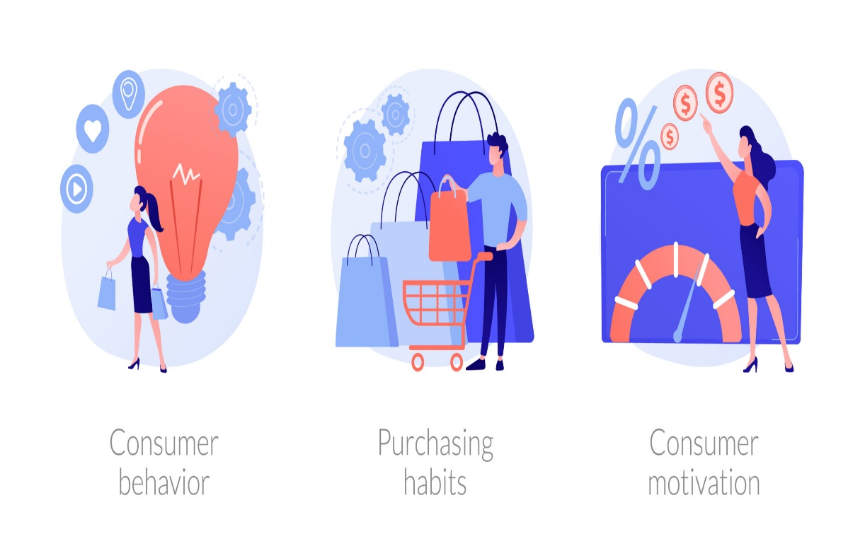
Introduction
This project aims to enhance marketing strategies and customer retention for an e-commerce company by gaining a deeper understanding of their customer base based on their purchasing patter.
The goal is to develop a robust customer segmentation model and a predictive classifier to categorize customers based on their purchasing patterns, enabling the company to tailor marketing strategies, improve customer retention, and optimize inventory management.

Slide 3
Exploratory Data Analysis (EDA)
Handle missing values
Drop the rows having missing values of description feature and CustomerID feature.
To convert the invoice Date into proper format
Fine maximum date of invoice Date to calculating the difference between two dates of the customers
Feature Scaling using StandardScaler (Z-score Normalization)
StandardScaler is a feature scaling method that transforms data

Slide 4
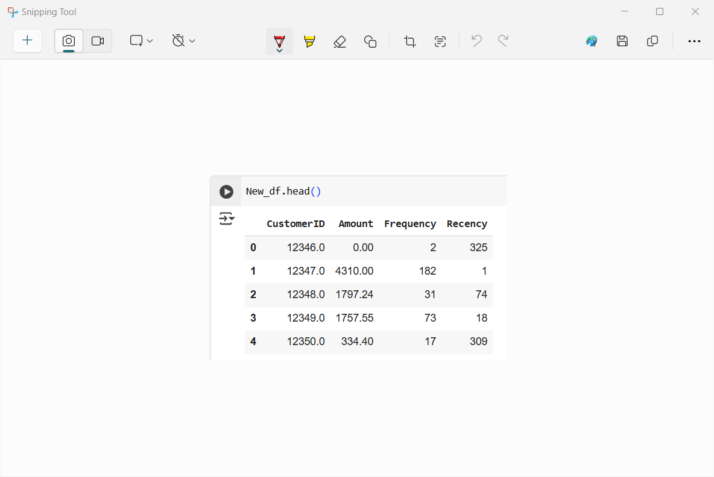
Analyze Customer Purchasing Behavior
segement the Customers based on RFM so that the company can target its customers efficiently.
R (Recency): Number of days since last purchase
F (Frequency): Number of tracsactions
M (Monetary): Total amount of transactions

Slide 5
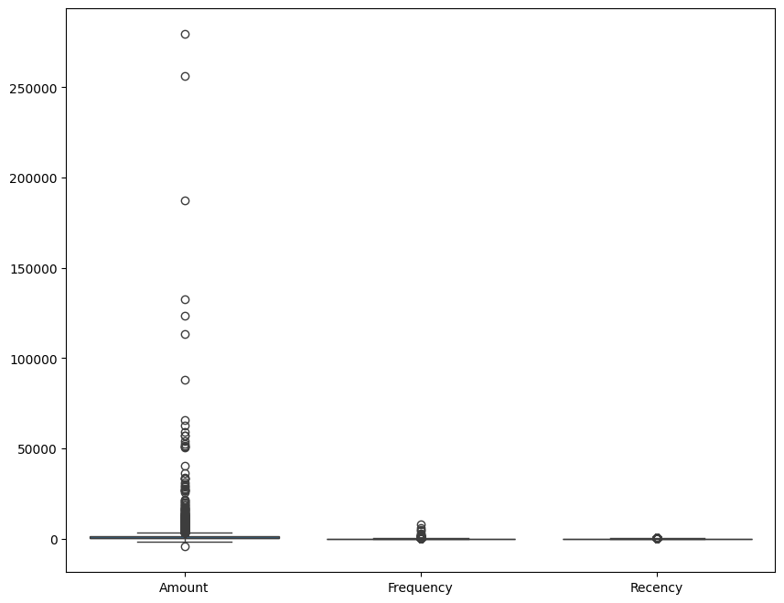
Handling Outliers
There many outliers in Amount, few in frequency and Recency features.
To remove outliers from the ‘Amount’ , ‘Recency’ and ’Frequency’ using the Interquartile Range(IQR)
Compute IQR
IQR=Q3-Q1

Slide 6
Model Selection & Training
Models used: K-means, hierarchical clustering, and DBSCAN
Model Evaluation:
1. K-means(60%):- has the good accuracy and works well for spherical,
well-separated clusters.
2. hierarchical clustering(57%):-is low accuracy and Computationally
expensive for large datasets
3. DBSCAN(64%):-has the highest accuracy, but is slower for
large datasets.

Slide 7
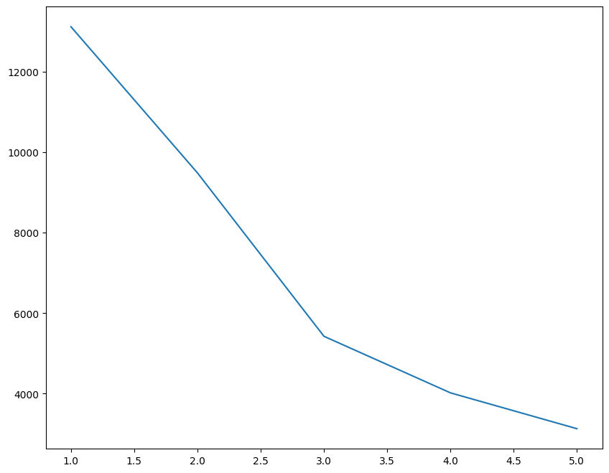
. K-means
K-Means is an unsupervised machine learning algorithm used for clustering
Elbow Method
The Elbow Method:- helps find the best value of K by analyzing how well the clusters fit the data.
Choosing K=3 :-the ‘elbow’ in
the plot where the reduction
in WCSS start to level off suggests
that 3 clusters capture
most of the datas structure

Slide 8
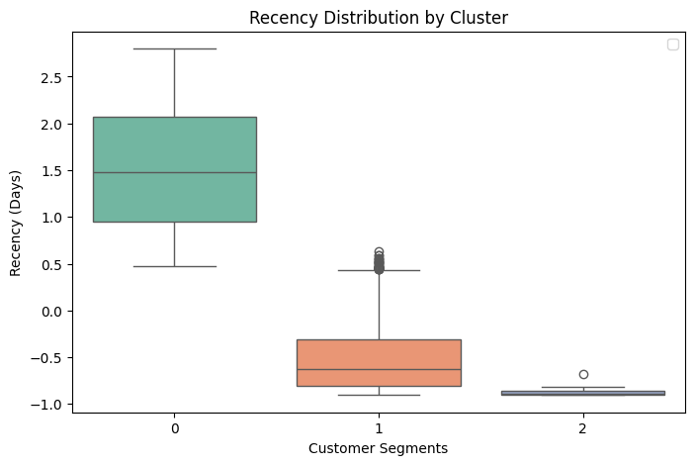
K-means
Cluster 0:- has highest recency values customers in this group haven’t made a purchase recently.
Cluster 1:- This group has a lower recency than Cluster 0 ,most customers have made puchases more recently
Cluster 2:- This segment has very low recency (close to zero)customers in this group have purchases very recently.

Slide 9
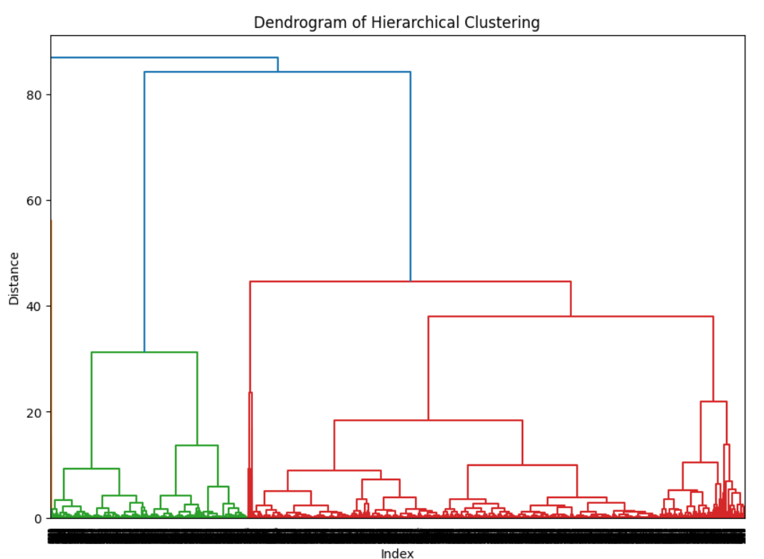
Hierarchical Clustering
Hierarchical clustering is a way to group similar things together step by step, like making a family tree.
The green ,red,and blue sections represent different clustere.The higher merges in blue show that these cluster are are quite different from each other
This dendrogram suggest that 3 clusters might be a good coise the large vertical gaps at the top indicate clear separation between the main clusters

Slide 10
DBSCAN
DBSCAN (Density-Based Spatial Clustering of Applications with Noise
is a great choice for customer segmentation
DBSCAN clustering has a Silhouette Score of 0.6436.
0.64 is a relatively good score, indicating that clusters are well-separated and the points are assigned to the correct clusters.
This means DBSCAN effectively grouped similar customers together while keeping outliers separate.

Slide 11
Conclusion
K-means performs best with large dataset and It has good
accuracy efficient, scalable, and simple to implement.
DBSCAN has the highest accuracy but it is slower for large data set.
Hierarchical clustering has is low accuracy.

Slide 12
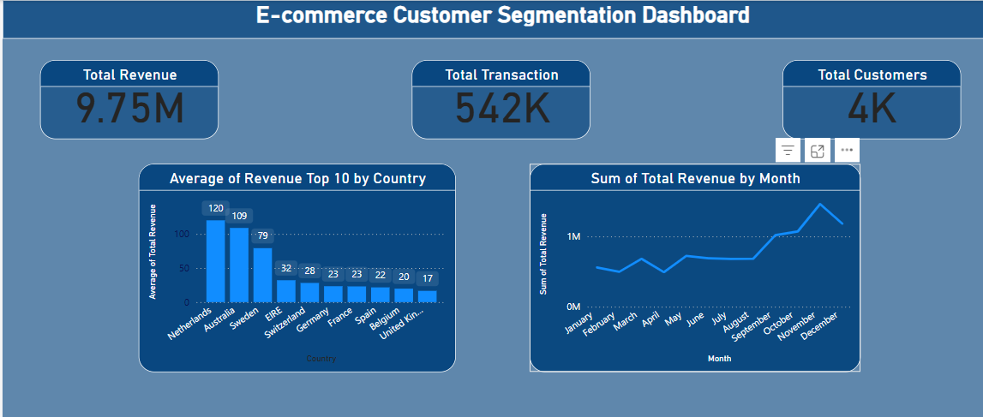

Slide 13
Thank You!

